Slide 1
The Observer Pattern
Brendan Kay
Gavin Forsberg

Slide 2
What is the observer pattern? - Formal Definition
Formal definition:
The Observer Pattern defines a one-to-many dependency between objects so that when one object changes state, all of its dependents are notified and updated automatically.
The Observer Pattern provides an object design where subjects and observers are loosely coupled.
Head First Design Patterns - Freeman

Slide 3
What is the observer pattern? - Informal Description
Think of it like a newspaper.
There are publishers that push out data and subscribers who want to receive updates on new data.
You can subscribe and unsubscribe to the publisher whenever you want.
Publishers = Subject
Subscribers = Observers

Slide 4
Our concept
We have created a very basic social media platform in order to replicate the observer design pattern.
This platform consists of 2 friends, Alice and Bob, who receive updates about the main character’s status.
Bob has been designated as a best friend, while Alice was left as a normal friend.

Slide 5
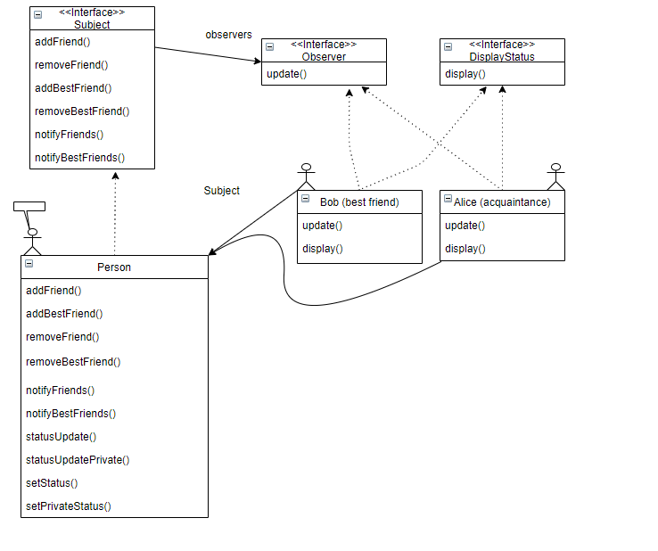
Class Diagram

Slide 6
Applicability / Faults
While this is a good design pattern for spreading information to different sources utilizing loosely linked objects, we cannot justify using our implementation for an actual social media site.
This is not the best pattern to use for this specific project for the following reasons:
New classes for each person in the friend circle.
One-way communication (only main character can post status).
Friends cannot connect to each other.
Observers would have to be “Persons” as well.
Overall, an interesting perspective, but relatively useless without adding more functionality to it that was not required to showcase the concept.

Slide 7
More on loose coupling / benefits
When two objects are loosely coupled, they can interact, but have very little knowledge of each other.
The only thing the subject knows about an observer is that it implements a certain interface.
We can add observers (friends) any time
We don’t need to modify the subject to add more friends.
Changes to the subject will not affect the observer and vise versa.

Slide 8
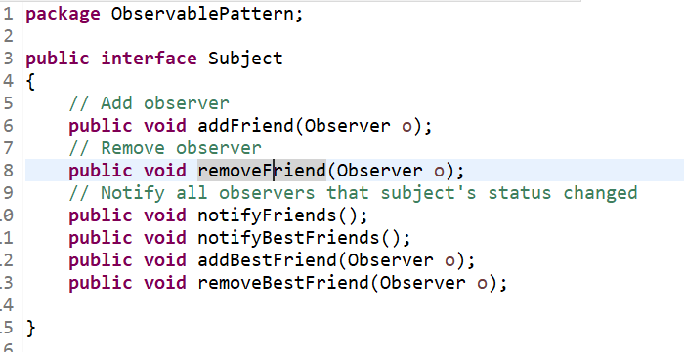
Subject

Slide 9
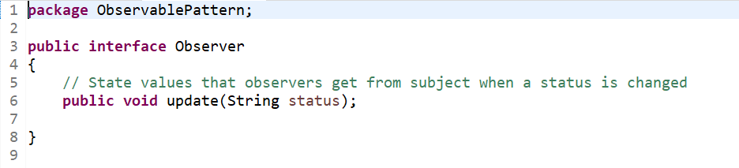
Observer

Slide 10
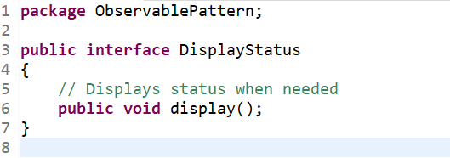
DisplayStatus

Slide 11
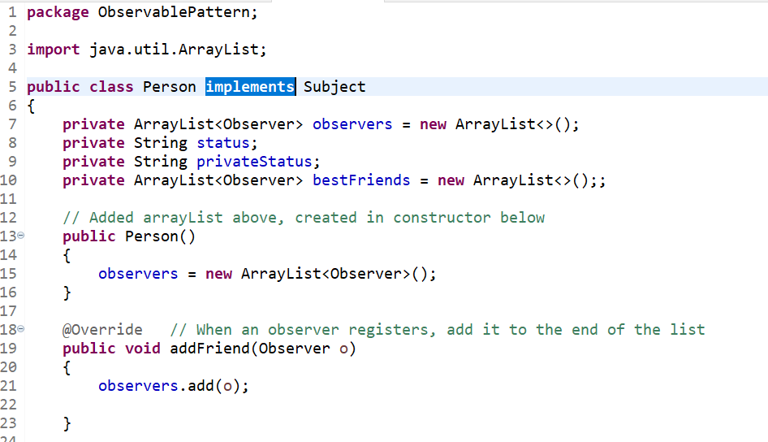
Person (¼)

Slide 12
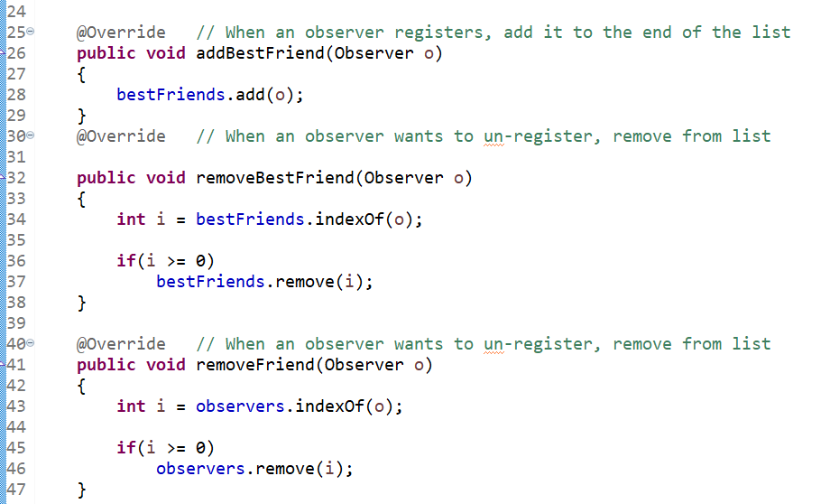
Person (2/4)

Slide 13
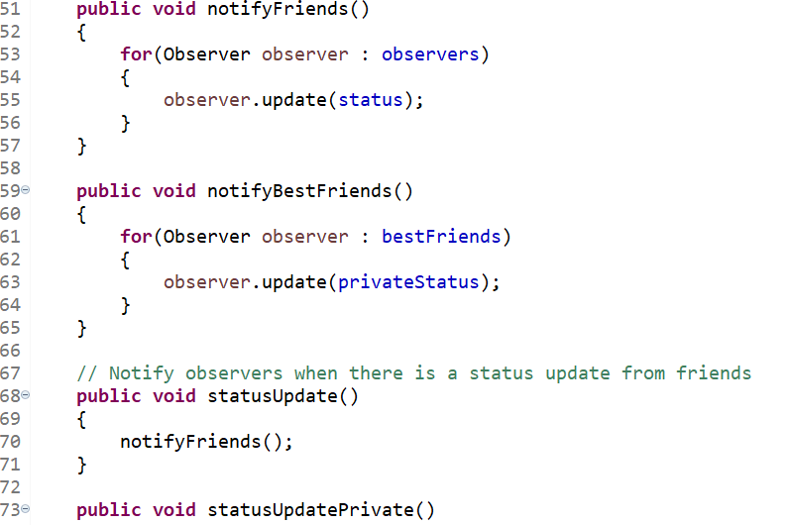
Person (¾)

Slide 14
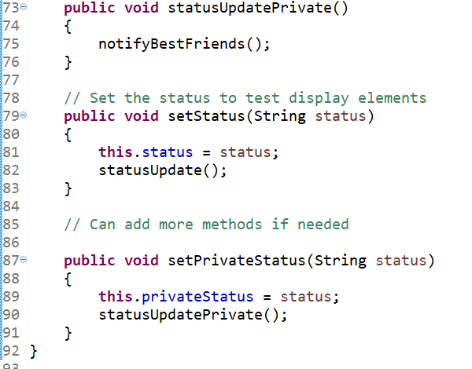
Person (4/4)

Slide 15
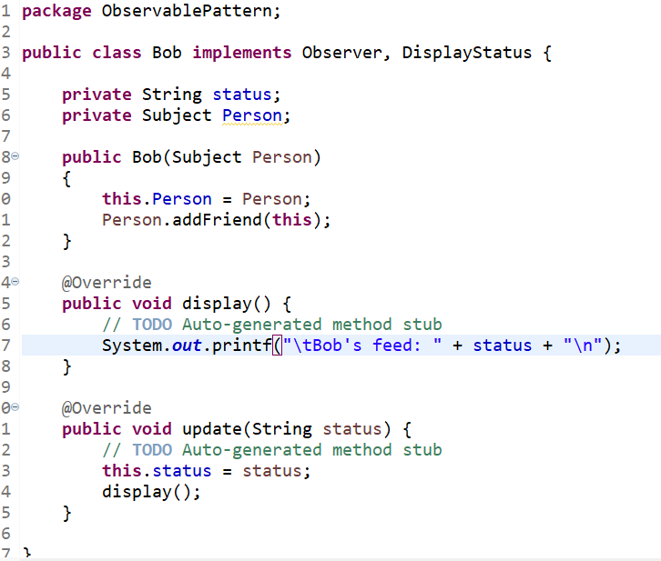
Bob

Slide 16
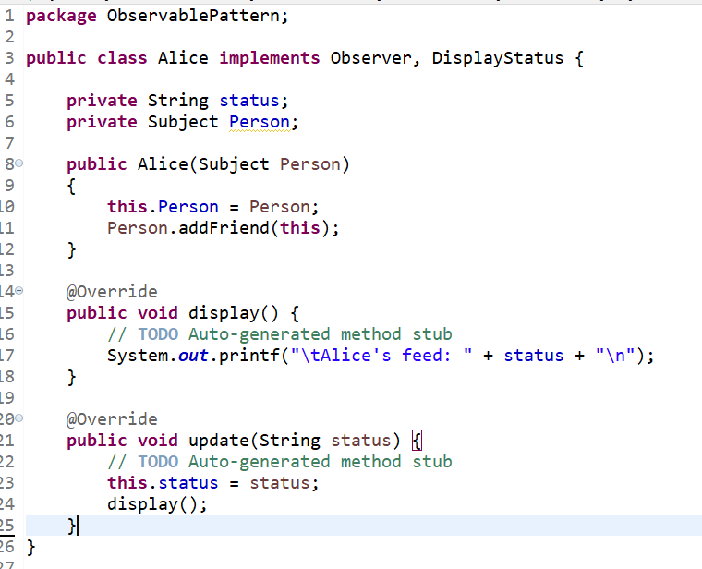
Alice

Slide 17
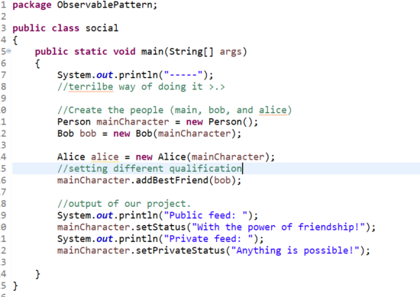
Social (Main Class)

Slide 18
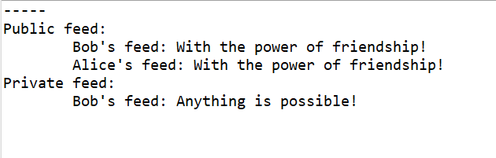
Compiled Solution

Slide 19
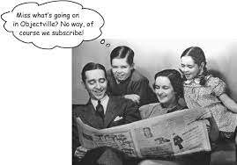
What we learned (Challenges)
A new approach to object oriented programming.
Loose coupling of data structures.
Group coding dynamics.
Head First Design Patterns - Freeman

Slide 20
Contributions
Code written - roughly 50/50, with bug fixing being done as the code was written.
Powerpoint - Put together by Brendan, edited by Gavin.
Written Report - Put together by Gavin, edited by Brendan.
Github Issues - Written by Brendan after discussion with Gavin.

Slide 21
References
Freeman, E., & Freeman, E. (2004). Head first design patterns. Cambridge: O'Reilly.

Slide 22
Questions?

